Slide 1
Simple Iterative Sorting
Sorting as a means to study data structures and algorithms
Historical notes
Swapping records
Swapping pointers to records
Description, efficiency and source codes of some iterative sorts
Do faster sorts exist ?
Comparison of sort efficiencies

Slide 2
Sorting as a means to study data structures and algorithms
Programming is inherently difficult and involves much work. It isn't possible for students to create new applications for all relevant and important data structures and algorithms covered in this module in the time available. But most of the fundamental data structures and algorithms which we will be covering lend themselves to different approaches to sorting.
Understanding how these sorts work and how well these sorts perform is a useful key to our understanding the properties of the data structures and algorithms concerned. Once we have done this we will be better placed to be able to select appropriate data structures and algorithms needed to solve difficult programming problems.

Slide 3
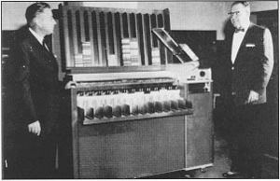
Historical note 1
When computers were first built, these were much too expensive to be used for something as trivial as sorting a collection of records into key order. Dedicated punched card sorting hardware was used instead, in order to pre-process input data to the valuable computer. This kind of hardware was still in use in many places in the early 1970ies.

Slide 4
Historical note 2
When early computers were used for sorting, there was often too much data to be sorted to be able to fit it all into RAM at the same time. Algorithms were developed in order to load sections of data into RAM from tape or disk. The time taken for these sort algorithms was dominated by the amount of input/output needed and how this could be optimised by the "external sorting" algorithm. The term "internal sorting" was used for modern algorithms where all of the data could be loaded into RAM at once.

Slide 5
Exchanging records 1
Iterative sorting routines involve a number of passes through the array to be sorted. Each pass will involve comparing the key fields of various records, and depending on the outcome of the comparisons, some record pairs will be swapped. ‘C’ enables all of a record to be moved from one storage location to another in a single statement.
Swapping two records with each other will require three moves and involve a third temporary record.

Slide 6
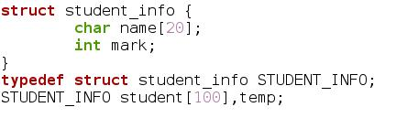

Exchanging records 2
Assuming the following declarations:
Then to swap records indexed by i and j:

Slide 7
Swapping pointers to records
The effort involved in swapping records might be reduced if pointers to the records can be swapped instead because the pointers are smaller. By having a seperate array of pointers to the records, the array of pointers can be sorted instead of the records themselves. The unsorted records can then be output in sorted order by using the sorted array of pointers.

Slide 8
Efficiency of sorting algorithms
This depends upon how many record moves and how many key comparisons are needed, in relation to the number of records to be sorted.It is possible to study algorithms analytically in order to estimate the expected numbers of comparisons and moves.
These numbers can then be compared to the actual numbers of record moves and key comparisons if these are counted when they occur. The analysis can only be approximate because the actual numbers of moves and comparisons will vary, depending upon the starting state of the set of records, but this can be averaged.

Slide 9
Exchange sort algorithm
Compare the first item with each item in turn. Exchange the pair if the first item is larger. At the end of the first pass, the smallest item will be at the start. Repeat the second and subsequent items after the ith pass (n-i) items remain to be sorted. (n-1) passes will be required.

Slide 10
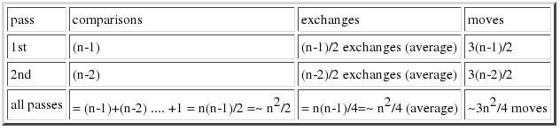
Exchange sort efficiency

Slide 11
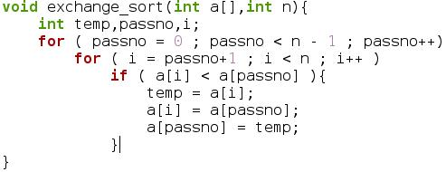
Exchange sort source code

Slide 12
Selection sort algorithm
The selection sort searches the array for the record with the smallest key, and then swaps this record for the first record in the array. The second pass repeats the process except that it starts with and swaps the second record for the record with the smallest remaining key. Thus each pass only requires one record swap.

Slide 13
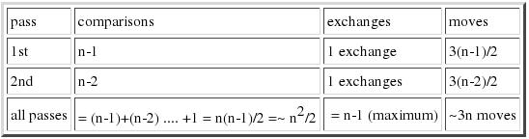
Selection sort efficiency

Slide 14
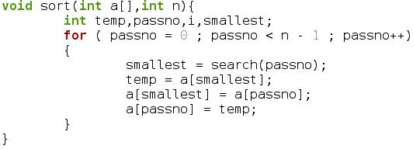
Selection sort source 1

Slide 15
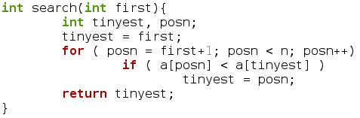
Selection sort source 2

Slide 16
Bubble sort algorithm
Compare the 1st and 2nd items and exchange, if necessary, so that the smaller is in the 1st position.
Repeat for the 2nd and 3rd pair, 3rd and 4th pair etc until a pass through all adjacent pairs has been made.
At the end of this first pass the last item will be in its proper place (i.e. it will be the largest).
Perform a second pass on the first (n-1) items, after which the last 2 items will be in place.
(n-1) passes will be required to sort an array containing n items.
At the end of the ith pass the last i items will be ordered.
If the pass is made in which no exchanges are required, then the list is in order, even if less than (n-1) passes have been made.

Slide 17
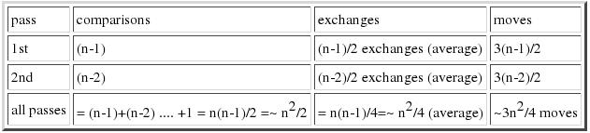
Bubble sort efficiency

Slide 18
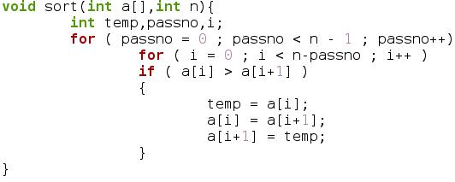
Bubble sort source

Slide 19
Insertion sort algorithm
Compare item 1 & 2. Exchange if necessary so that the smaller is in position 1. For items 3... n, search the already ordered portion of the array for the correct point to insert the next item. (item i, say). In order to insert the item at this point, it will be necessary to move all the following sorted items up one, so that the last ordered item overwrites the location previously occupied by item i.
Note that the search for the correct place to insert each item in the already sorted part of the array may be achieved using either a linear or a binary search, which leads to either a linear insertion sort, or to a binary insertion sort.

Slide 20
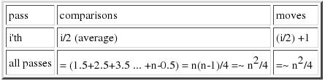
Linear insertion sort efficiency

Slide 21
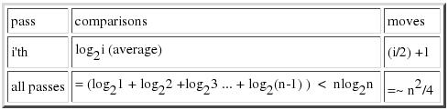
Binary insertion sort efficiency

Slide 22
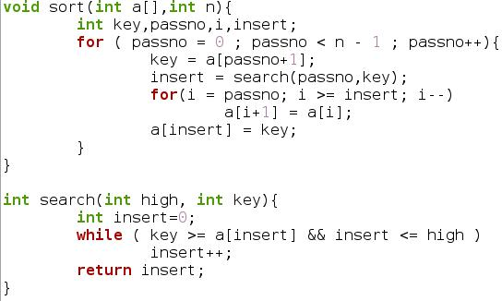
Insertion sort code

Slide 23
Do faster sorts exist ?
Much faster sorts than the ones above exist. These use recursive algorithms or different data structures. The simplest (though not the fastest) recursive sort is called merge sort. To understand this, take a shuffled pack of cards, split it in 2 smaller packs and sort each half, and then merge the 2 halves.
Q. How do we sort the 2 halves ?
A. We sort any sub pack in the same way we sort the whole pack, except for sub packs of size 1 which are already sorted.
Q. How many times can we split a pack of N cards into 2 packs before we get to a packs of size 1 ?
A. log₂N

Slide 24
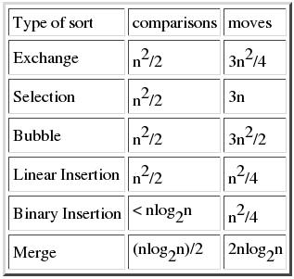
Summary of sort efficiencies

